Slide 1
Credit Card Validator
Based on Luhn Algorithm
Submitted in the partial fulfillment for the award of the degree of
BACHELOR OF ENGINEERING
IN
Computer Science & Engineering (AI&ML)
Submitted by:
Shreyansh Dwivedi
20BCS6076
Under the Supervision of:
Mrs. Nishu Bansal
Department of AIT-CSE
DISCOVER . LEARN . EMPOWER

Slide 2

Outline
Introduction to Project
Problem Formulation
Objectives of the work
Methodology used
Results and Outputs
Conclusion
References

Slide 3

Introduction to Project
Our project uses Luhn algorithm to validate a credit card and it is the first line of defense in many e-commerce sites and is used to validate a variety of identification numbers such as credit card numbers.
Many random numbers exist and at such volumes, the websites or any platform that accepts online payments cannot distinguish among these numbers and a valid credit card number easily.
Our project analyses, validates and identifies the user input of a credit card number, and deems it valid or invalid based on the input. This also makes it easier to detect fraudulently created credit cards or credit cards that are no longer active. The validator is expected to be useful for many payment gateways that use credit cards as a mode of payment.

Slide 4

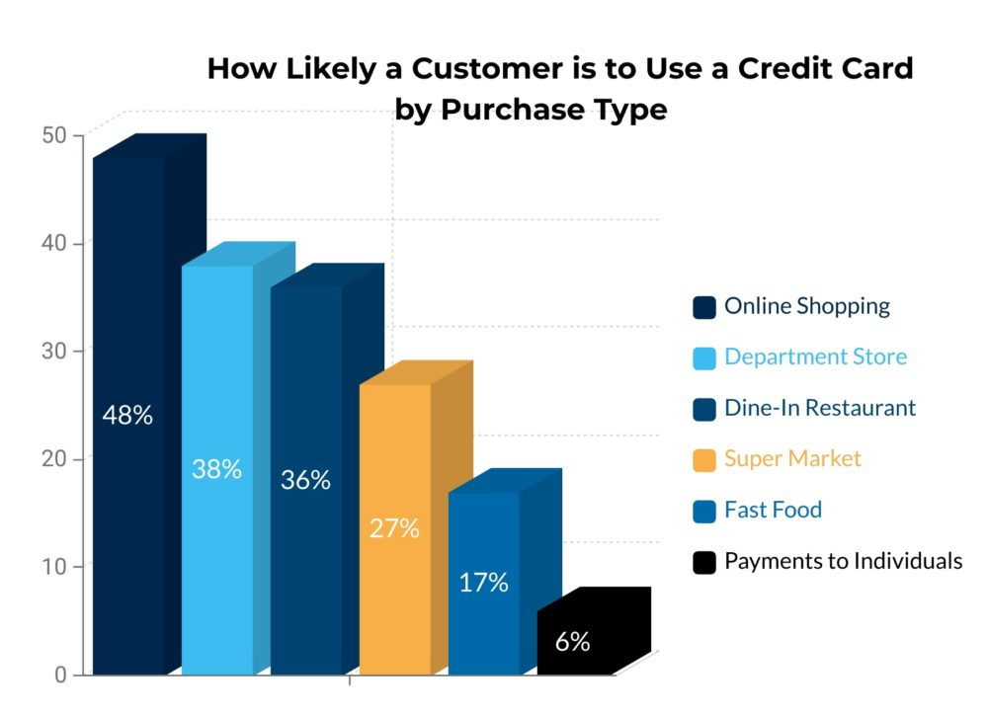
Problem Formulation
Credit cards are the most frequently used payment methods, accounting for about 48% of all online transactions.
With increasing credit card usage on the Internet, comes a dramatic increase in online frauds and also typing errors are one of the most common issues that occur when a user attempts to type his/her CC number at the payment gateways.

Slide 5
Problem Formulation
It is important to keep in mind that whenever fraudulent or stolen cards are used, the merchant loses, credit card companies are generally not affected and neither the card holder.
If too many fraudulent transactions occur, merchant may incur higher processing fees, expensive chargebacks, or even losing their merchant account and their ability to do business.
Merchants can mitigate these risks with the help of a little automation, and we can help them! Simply use our Credit Card Validator tool and our tool will help them to combat fraud and maximize the sales with low processing fees.

Slide 6
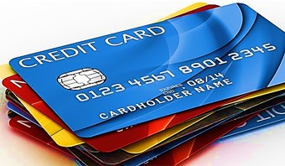
Objectives
To develop a credit card validator that can help to validate bulk credit cards for card network companies as well as validate single input credit cards entered by users at payment gateways for merchants accepting credit card as payment mode.

Slide 7
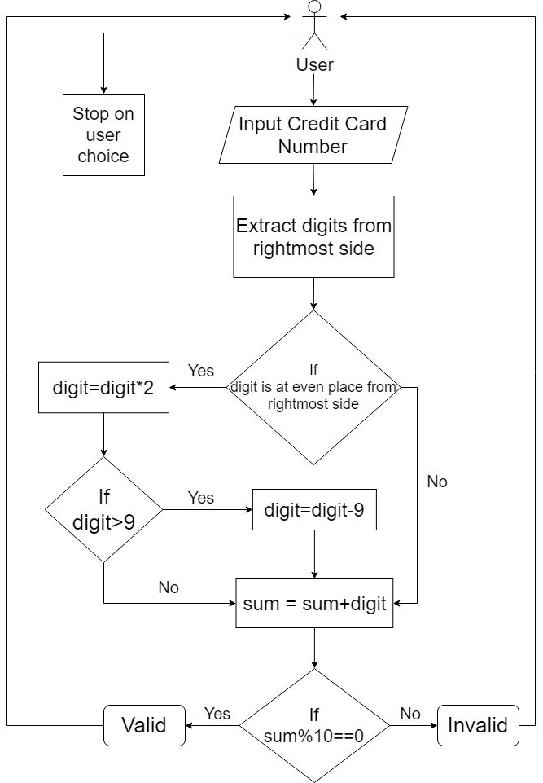
Methodology used
A menu driven program helps the user to choose between bulk validation using manual input or txt file and also by a single one time manual input.
User also gets choice to exit the program whenever he/she wants.
File handling has been used to handle bulk inputs through txt files, saving the time by not taking input manually. It is useful for card network companies to keep their databases updated about all fake credit cards.

Slide 8
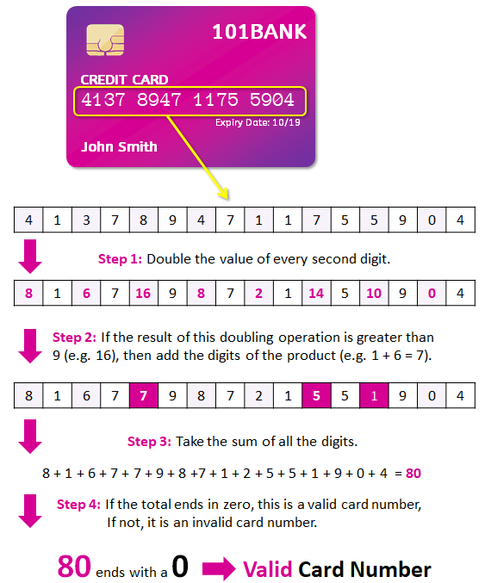
Methodology used
Apart from the validation process, our validator also identifies the card network (E.g. American Express or Visa, etc.)
The first digit on the credit card number from leftmost side helps to identify the network provider (E.g. 5486 xxxx xxxx 2973) 5 stands for MasterCard

Slide 9
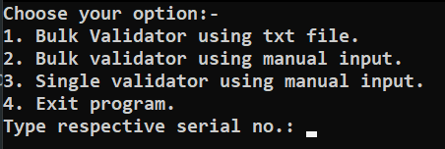
Results and Outputs
After pressing enter, it redirects to main menu.
I choose option 1.

Slide 10
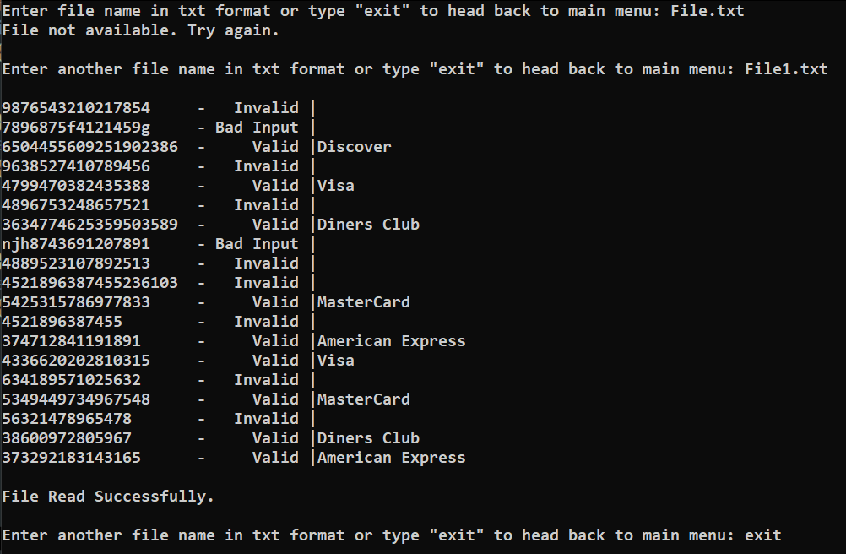
Results and Outputs
After typing exit, it redirects to main menu.

Slide 11
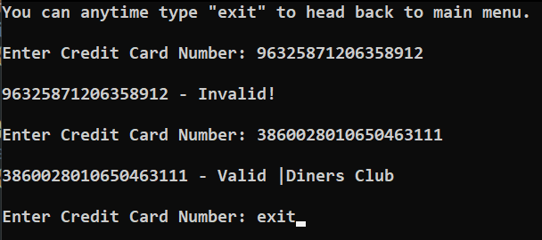
Results and Outputs
I choose option 2.
After typing exit, it redirects to main menu.

Slide 12
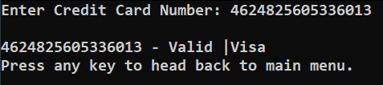
Results and Outputs
I choose option 3.
After pressing any key, it redirects to main menu.

Slide 13

Results and Outputs
I choose option 4.

Slide 14
Conclusion
The Luhn algorithm is widely used to validate credit card numbers and we are successfully able to implement it to detect fraudulent or invalid credit cards.
Our menu driven program also provides bulk validation to save time and for one time user, we have a feature to simply run the program once and then exit.
Emphasis on display has been put on both bulk and manual inputs.
If a card is found valid, then our program also helps to identify the card network and transaction request can be sent to relevant location.

Slide 15
References
• www.geeksforgeeks.com
• www.ripublication.com
www.ijcsmc.com
www.towardsdatascience.com
www.wikipedia.com

Slide 16


